Slide 1
#02 Inheritance and Polymorphism
Notes:
Give an explanation for the concepts inheritance and polymorphism
Relevant theoretical decisions
What is inheritance, when and how is it used?
How are the relationship between references and objects in an inheritance hierarchy?
What are static and dynamic types?
What is polymorphism, when and how is it used?
How do you understand the concepts early and late binding?
What is a polymorphic method?

Slide 2
Class

Slide 3
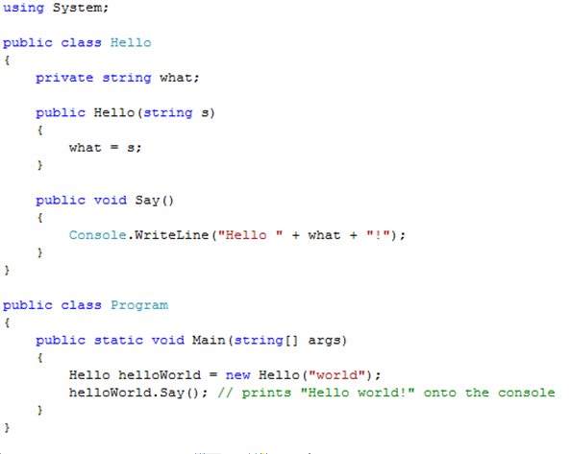
Class Example and Visibility

Slide 4

Interfaces
“An interface is a contract that guarantees to a client how a class will behave”
A Class can implement more the one interface
Interfaces can be extended and combined

Slide 5
Abstract Class

Slide 6
Abstract Class Vs Interface

Slide 7
Garbage Collector
C# performs automatic garbage collection
Collection/removing objects that are marked as garbage
Object that no longer has a reference
C# programmers don’t need to worry about explicitly reclaiming memory that has become garbage

Slide 8
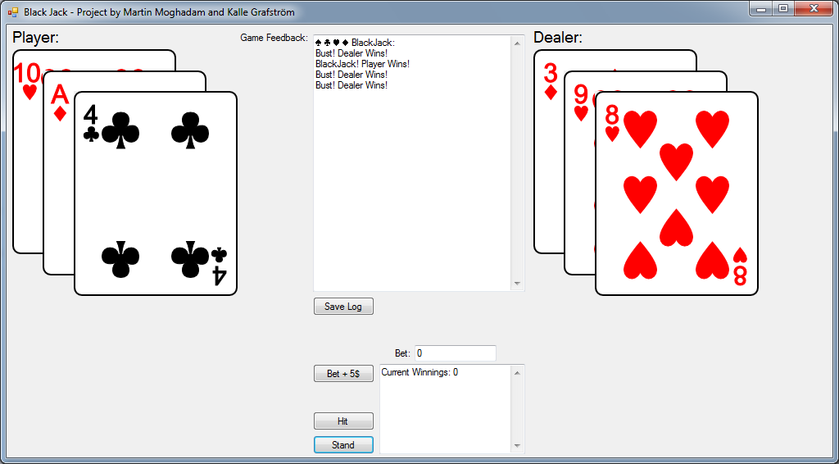
Our program
Black Jack Game
Log
Save Log
Beting
Hit
Stand

Slide 9
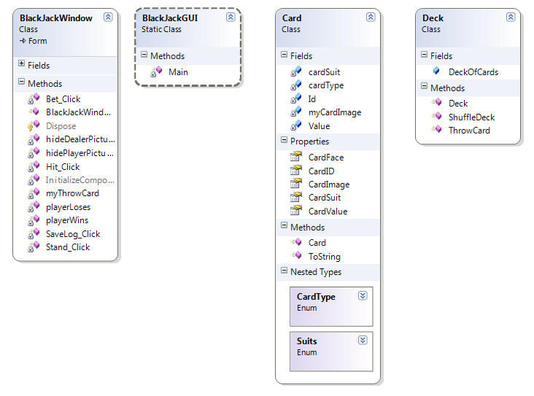
Our program
Notes:
Our application contains a simple card class, and a deck class.
A deck of cards is a list that contains objects of the type card.

Slide 10
Questions?

